Slide 1
Distributed Computer Systems
CT024-3-3 and Version VC1
Introduction and Overview

Slide 2
Lecturer information
Lecturer Name: Umapathy Eaganathan
Email: umapathy.eaganathan@apu.edu.my
Telephone Extension:

Slide 3
Pre-requisites for this module
CT043-3-1 Introduction to Networking and CT038-3-2 Object Oriented Development with Java or equivalent

Slide 4
Aims of this module
This module will focus on distributed systems and technologies such as Remote Method Invocation (RMI), Common Object Request Broker Architecture (CORBA), and Component Object Model (COM). Students will learn how distributed systems functioning in three tier network architecture (client, server and middleware) with supporting network protocols. Also students will be learning the standards of distributed systems related with enterprise business standards. Further the secure object oriented programming will be used to implement a distributed system by supporting fault-tolerance concepts.

Slide 5
Learning outcomes
At the end of this module, YOU should be able to:
Evaluate various distributed technologies to improve the quality of distributed enterprise applications based on the given case study (C5, PLO1)
Identify the future developments in distributed systems technology and standards with organizaton needs based on research. (A4, PLO6)
Propose an appropriate programming language and system facilities to develop distributed and fault-tolerant applications (A5, PLO7)

Slide 6
Mapping of CLOs with MOEs Domain
Mapping of the Course Learning Outcomes to the Programme Learning Outcomes, Teaching Methods and Assessment :
Course Learning Outcomes (CLO) | Programme Learning Outcomes (PLO) |  |  |  |  |  |  |  |  | Teaching Methods | Assessment
 | PLO1 | PLO2 | PLO3 | PLO4 | PLO5 | PLO6 | PLO7 | PLO8 | PLO9
CLO 1 | ü |  |  |  |  |  |  |  |  | Lecture, Tutorial | Exam
CLO 2 |  |  |  |  |  | ü |  |  |  | Case Study, Tutorial | Assignment
CLO 3 |  |  |  |  |  |  | ü |  |  | Case Study, Tutorial | Assignment
CLO 4
PLO1 – Knowledge
PLO3 – Problem Solving and Scientific Skills
PLO6 – Values, Attitude and Professionalism

Slide 7
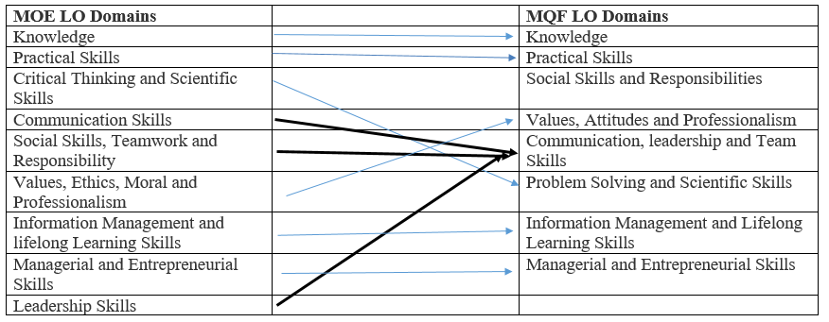
MQF and MOE Domains

Slide 8
Student Learning Time (SLT)
Module Credit Value:
Total Learning Hours:
Lecture: 18 hours per semester
Tutorial: x 24 hours per semester
Independent Learning Time: 54 hours

Slide 9
Methods of Delivery
Hence,
We are now moving from the traditional topic based teaching to outcome-based education

Slide 10
Outcomes Based Education (OBE)
OBE is education based on producing particular educational outcomes that:
Focus on what students can actually do after they are taught
Expect all learners / students to successfully achieve particular (sometimes minimum) level of knowledge and abilities.

Slide 11
So…What is OBE?
It’s
NOT
What we want to teach,
It’s
What You should learn

Slide 12
Topics we will cover
Distributed System Principles and Technologies
Processes ,Threads and Synchronization
Security Issues in Distributed Systems
Cloud Computing
Grid Computing
Virtualization
Name Services

Slide 13
Topics will be covered
Windows Communication Foundation
Internet Communication Engine
Sockets Programming
Shared Objects and Serialization

Slide 14
What is expected of you
What is expected of you
You should abide to all the rules & regulation of APU
Proper attire
No speaking of dialects
Attendance is compulsory and valid medical certificates or letters from parents /guardians must support any absence from class.
Three lateness will be equal to one absence
All pagers and handphones should be turned off during lectures.

Slide 15
What support is available for you
Consultation hours
Resources
Reference material
Internet resources

Slide 16
How you will be assessed
Incourse Assessment 60%
Individual assignment 60%
Hand out Hand in Return
Individual Exam 40%
Hand out Hand in Return
Week 02 Week 10 Week 14

Slide 17
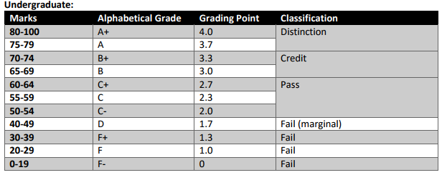
Achievement requirements

Slide 18
Question and answer session
Q & A

Slide 19
What we will cover next
Introduction and RPC

